Slide 1
PROJECT
INSURANCE ANALYTICS
( Excel, Power BI, SQL, Tableau )
GROUP – 3
Vidya Sree
Kavya
S. Raju
Rakesh
Shanthi Sri
Sunita

Slide 2
INTRODUCTION
This project showcases our end-to-end data analysis skills using Excel, SQL, Power BI, and Tableau. We worked with multiple datasets—covering meeting records, invoices, brokerage data, fees, and individual budgets.
The goal was to extract insights, track performance metrics, and create interactive dashboards to support decision-making. Each tool played a unique role in the data journey—from cleaning and transformation to visualization and storytelling.

Slide 3
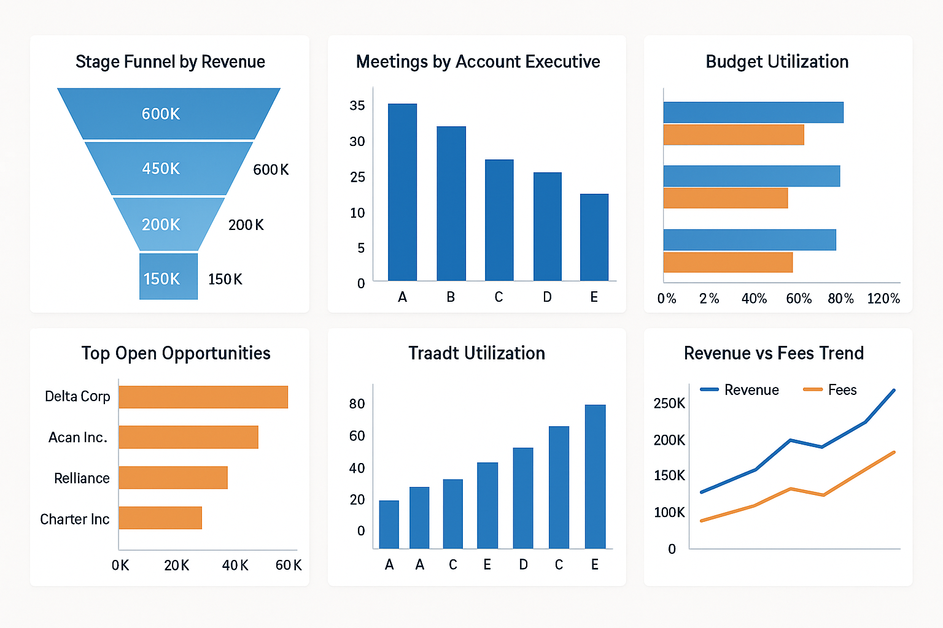
OBJECTIVES
To clean and combine multiple datasets from different sources.
To analyze key performance indicators (KPIs) such as revenue, meeting counts, and budget utilization.
To create dashboards for visualizing trends and performance.
To deliver actionable insights and recommendations for better business decisions.

Slide 4

DATA CLEANING PROCESS
Removed duplicates, null values, and irrelevant fields.
Standardized formats (dates, categories, numerical values).
Handled missing values with appropriate imputation.
Verified data consistency across datasets.
Ensured clean, structured data for analysis.

Slide 5
DATA OVERVIEW 1
Meeting Data: Information on Client meetings, account executives, and timestamps.
Invoice Data: Details of billed amounts and billing dates.
Brokerage Data: Records of commissions and brokerage earnings.
Fees Data: Different types of service fees charged.
Individual Budgets: Budgets assigned to teams or individuals.

Slide 6

DATA OVERVIEW 2
Using Excel, We began by cleaning and organizing the data. Power Query and Power Pivot helped to merge the datasets and create Data Models.
SQL was used for querying structure data and performing joins, aggregations, and filtering.
The refined data was visualized in Power BI and Tableau.

Slide 7
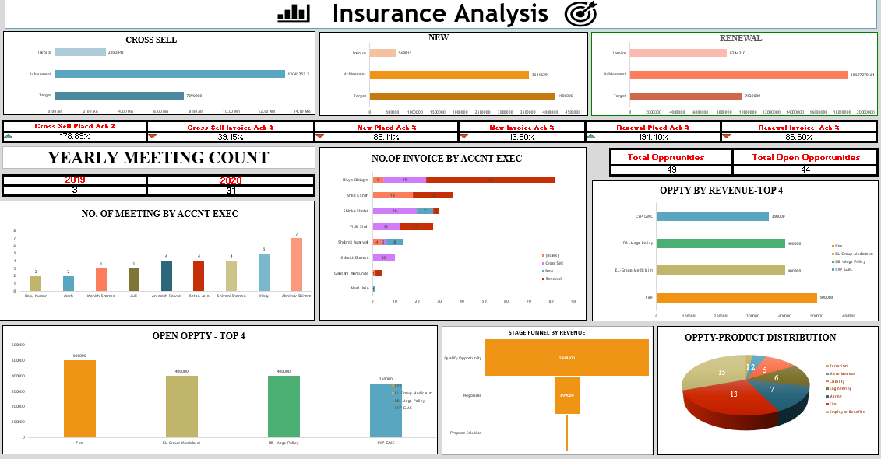
Excel Dashboard Preview

Slide 8
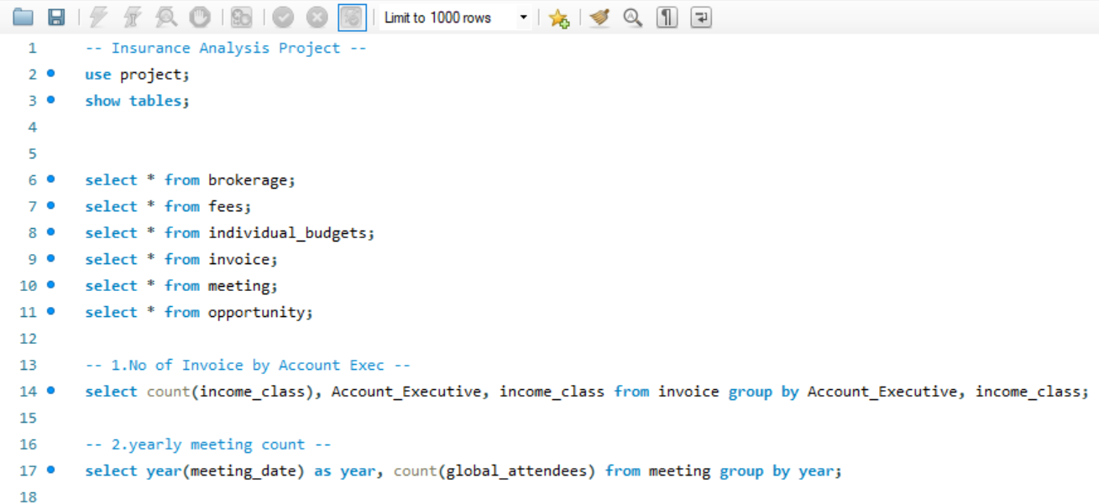
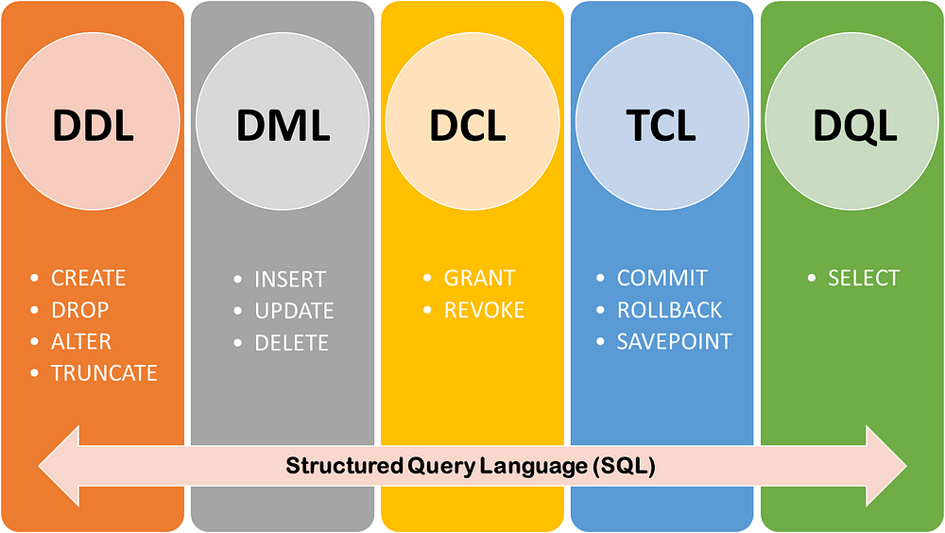
SQL Commands Preview

Slide 9
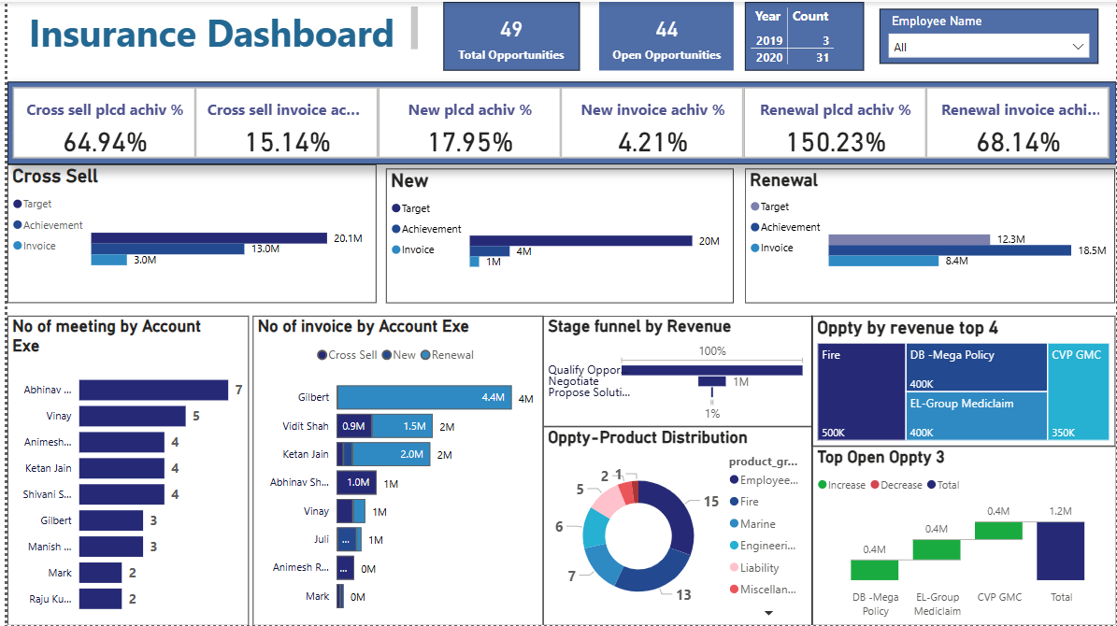
Power BI Dashboard Preview

Slide 10
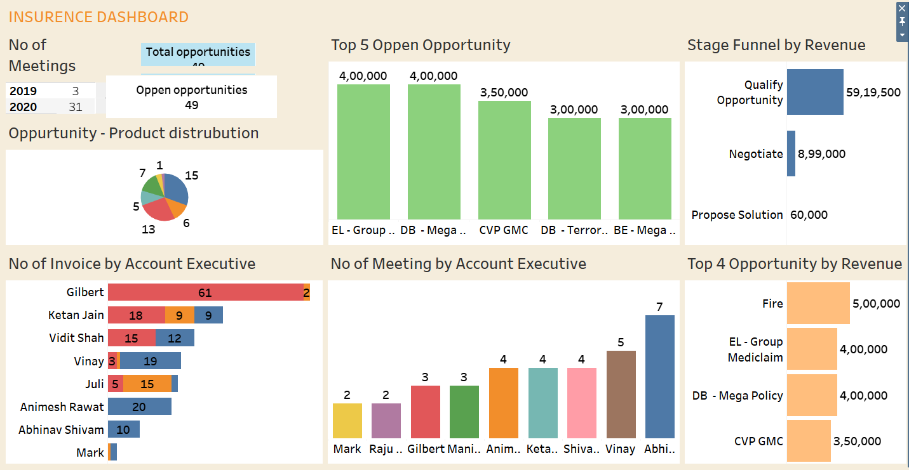
Tableau Dashboard Preview

Slide 11

CHALLENGES
Data Quality
Large Datasets
Complex KPIs
Evaluation
SQL Data Loading

Slide 12

CONCLUSION
Gained valuable business insights from data analysis.
Overcome data loading challenges using local data from different data source file in MySQL.
Provided actionable recommendations for improvement.
Focus on growth and efficiency moving forward.

